Slide 1


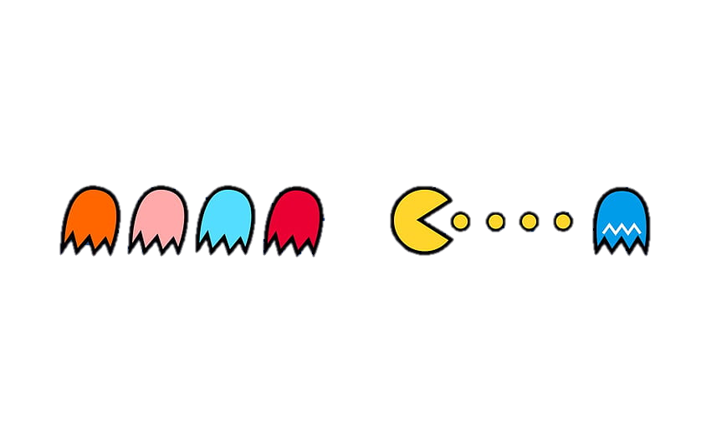
Pac-Man vs. Matlab
Optimization of Pac-Man strategies using Model Predictive Control
Identification and Optimal Control project– Professor Glielmo Luigi
Gargiulo Antonio – Giannotti Valentina – Grimaldi Emmanuel – Morghen Andrea
University of Naples Federico II – 6 July 2023

Slide 2
Summary
Environment Model
Maze model
Markov chains idea
Pac-Man model
Ghost model
Control Strategy
Pac-Man strategy
Model Predictive Control
Travel Salesman’s problem
Dynamic programming in stochastic framework idea
Simulation Results and Conclusions
Future developments
Gargiulo – Giannotti – Grimaldi – Morghen University of Naples Federico II – July 2023
Optimization of Pac-Man strategies using Model Predictive Control
SLIDE 1

Slide 3
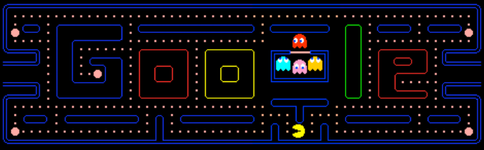
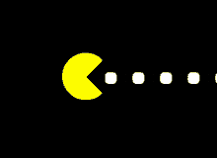
INTRODUCTION
Pac-Man game
Multiple-objective games
Control strategies generally used
Simplified version of the Pac-Man game in MATLAB
Gargiulo – Giannotti – Grimaldi – Morghen University of Naples Federico II – July 2023
Optimization of Pac-Man strategies using Model Predictive Control
SLIDE 2

Slide 4
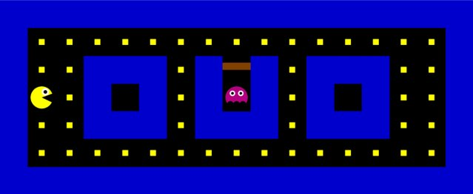
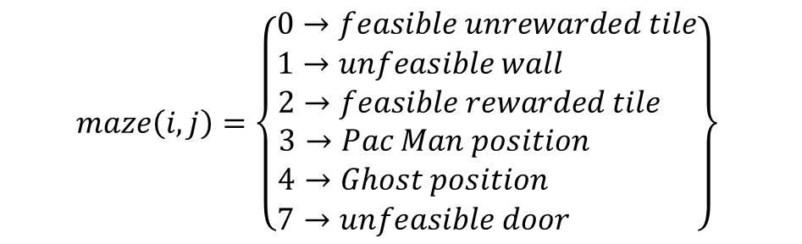
MAZE MODEL
$$maze\left(i,j\right)=\left\{\begin{aligned}0→feasible unrewarded tile \\ 1→unfeasible wall \\ 2→feasible rewarded tile \\ 3→Pac Man position \\ 4→Ghost position \\ 7→unfeasible door \end{aligned}\right\}$$
Matrix-based representation
Maze evolution
Gargiulo – Giannotti – Grimaldi – Morghen University of Naples Federico II – July 2023
Optimization of Pac-Man strategies using Model Predictive Control
SLIDE 3

Slide 5
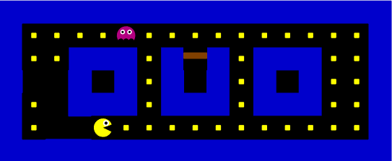
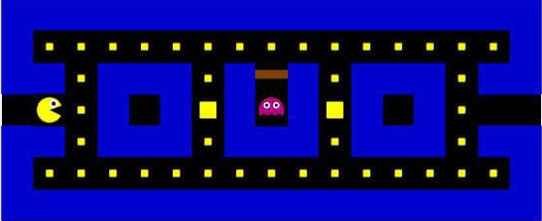
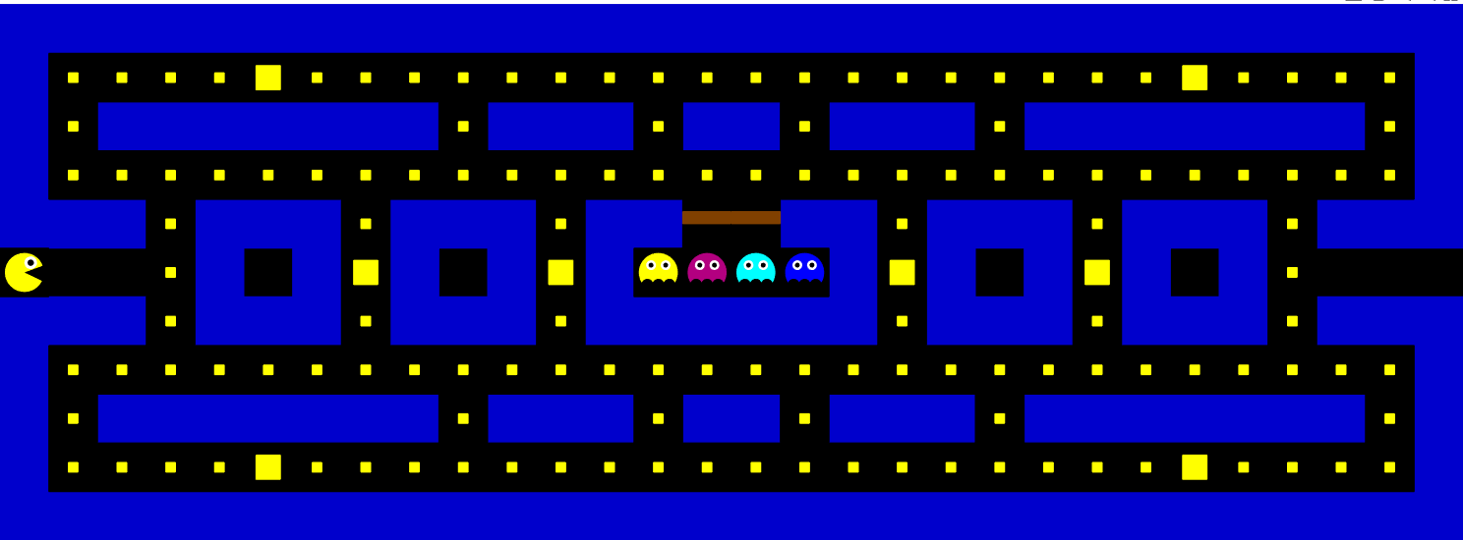
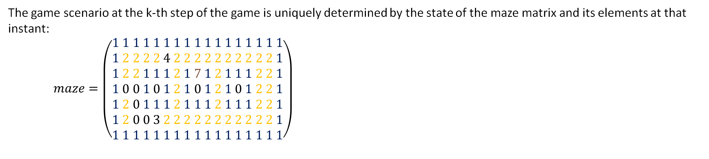
EVOLUTION AND PORTABILITY
The game scenario at the k-th step of the game is uniquely determined by the state of the maze matrix and its elements at that instant: $maze=\left(\begin{aligned}1 1 1 1 1 1 1 1 1 1 1 1 1 1 1 1 1 \\ 1 2 2 2 2 4 2 2 2 2 2 2 2 2 2 2 1 \\ 1 2 2 1 1 1 2 1 7 1 2 1 1 1 2 2 1 \\ 1 0 0 1 0 1 2 1 0 1 2 1 0 1 2 2 1 \\ 1 2 0 1 1 1 2 1 1 1 2 1 1 1 2 2 1 \\ 1 2 0 0 3 2 2 2 2 2 2 2 2 2 2 2 1 \\ 1 1 1 1 1 1 1 1 1 1 1 1 1 1 1 1 1\end{aligned}\right)$
The game model we implemented turns out to be portable to larger mazes with advanced game features…
POWER UP & PACMAN EFFECT IMPLEMENTATION
MULTI-AGENTS IMPLEMENTATION
Gargiulo – Giannotti – Grimaldi – Morghen University of Naples Federico II – July 2023
Optimization of Pac-Man strategies using Model Predictive Control
SLIDE 4

Slide 6
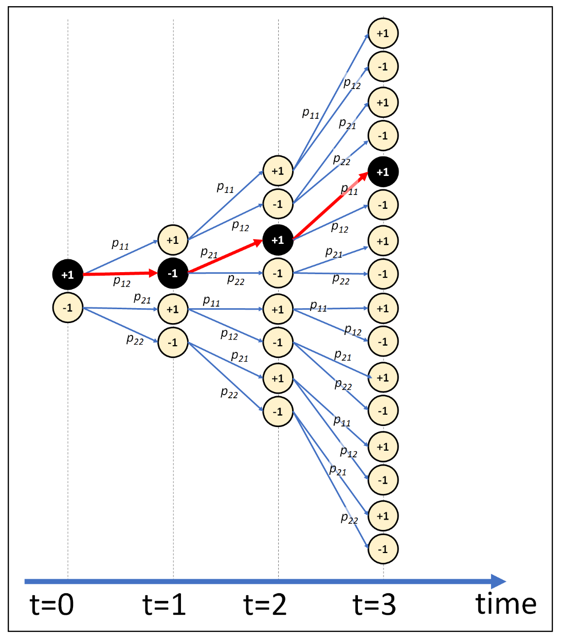
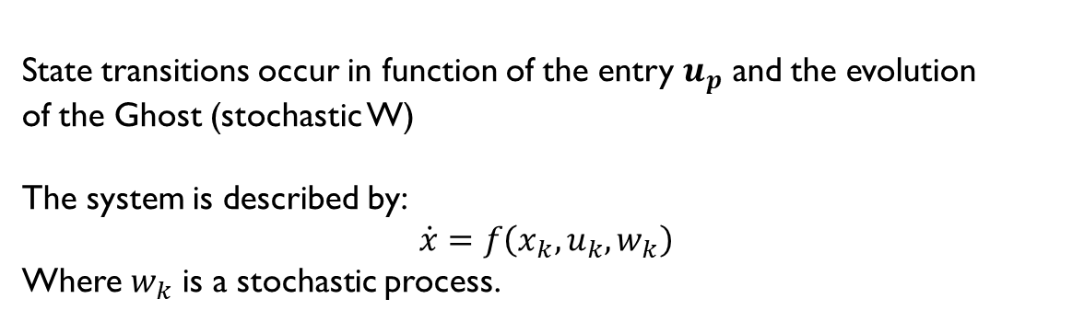
MODELLING MAZE WITH MARKOV CHAIN
Another possible implementation might be to consider the evolution of the game as a sequence of equiprobable (or not) states of the maze matrix.
State transitions occur in function of the entry $u_{p}$ and the evolution
of the Ghost (stochastic W)
The system is described by:
$$\dot{x}=f\left(x_{k},u_{k},w_{k}\right)$$
Where $w_{k}$ is a stochastic process.
Computationally very onerous!
Example of an increasing exponential growth of cases in Markov Chains
Gargiulo – Giannotti – Grimaldi – Morghen University of Naples Federico II – July 2023
Gargiulo – Giannotti – Grimaldi – Morghen University of Naples Federico II – July 2023
Optimization of Pac-Man strategies using Model Predictive Control
SLIDE 5

Slide 7
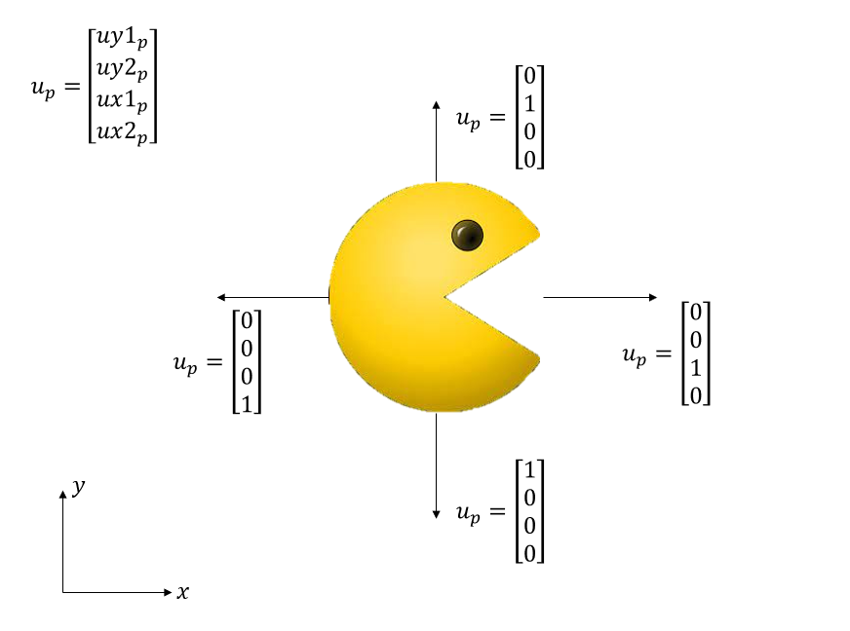
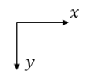
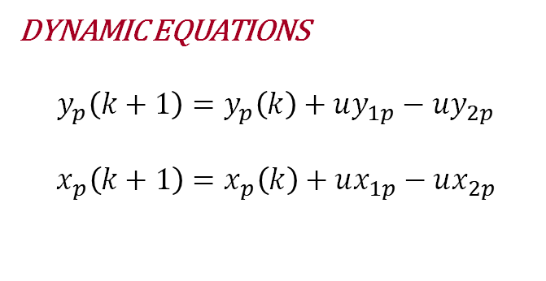
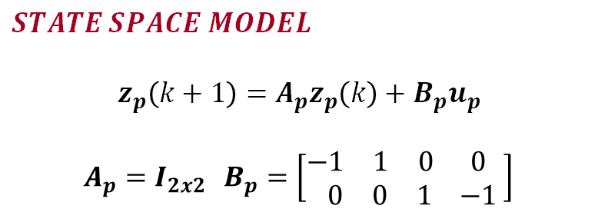

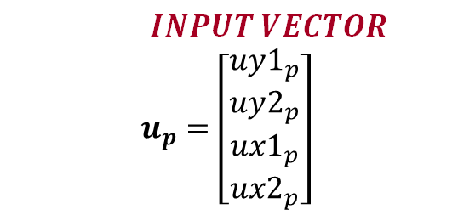
PAC-MAN MODEL
DYNAMIC EQUATIONS
$$y_{p}\left(k+1\right)=y_{p}\left(k\right)+uy_{1p}−uy_{2p}$$
$$x_{p}\left(k+1\right)=x_{p}\left(k\right)+ux_{1p}−ux_{2p}$$
$$STATE VECTOR$$
$$z_{p}=\left[\begin{aligned}y_{p} \\ x_{p}\end{aligned}\right]$$
$$INPUT VECTOR$$
$$u_{p}=\left[\begin{aligned}uy1_{p} \\ uy2_{p} \\ ux1_{p} \\ ux2_{p}\end{aligned}\right]$$
$$STATE SPACE MODEL$$
$$z_{p}\left(k+1\right)=A_{p}z_{p}\left(k\right)+B_{p}u_{p}$$
$$A_{p}=I_{2x2 } B_{p}=\left[\begin{matrix}\begin{matrix}−1 & 1 & 0 \end{matrix} \\ \begin{matrix} 0 & 0 & 1\end{matrix}\end{matrix} \begin{matrix}0 \\ −1\end{matrix} \right]$$
Pac-Man Model
Gargiulo – Giannotti – Grimaldi – Morghen University of Naples Federico II – July 2023
Optimization of Pac-Man strategies using Model Predictive Control
SLIDE 6

Slide 8
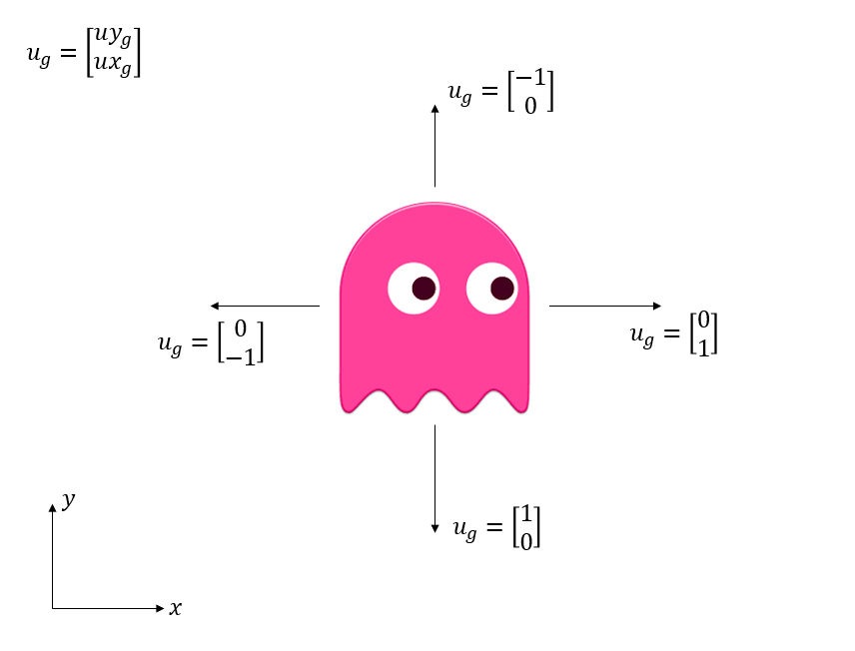
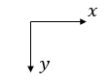
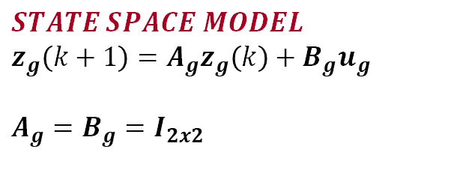
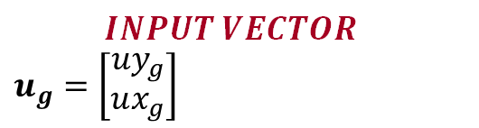
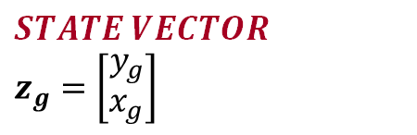
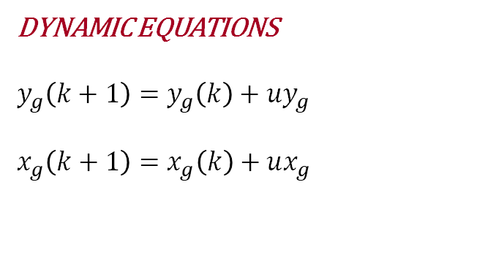
GHOST MODEL
DYNAMIC EQUATIONS
$$y_{g}\left(k+1\right)=y_{g}\left(k\right)+{uy}_{g}$$
$$x_{g}\left(k+1\right)=x_{g}\left(k\right)+ux_{g}$$
$$STATE VECTOR$$
$$z_{g}=\left[\begin{aligned}y_{g} \\ x_{g}\end{aligned}\right]$$
$$INPUT VECTOR$$
$$u_{g}=\left[\begin{aligned}uy_{g} \\ ux_{g}\end{aligned}\right]$$
$$STATE SPACE MODEL$$
$$z_{g}\left(k+1\right)=A_{g}z_{g}\left(k\right)+B_{g}u_{g}$$
$$A_{g}=B_{g}=I_{2x2}$$
Ghost model
Gargiulo – Giannotti – Grimaldi – Morghen University of Naples Federico II – July 2023
Optimization of Pac-Man strategies using Model Predictive Control
SLIDE 7

Slide 9
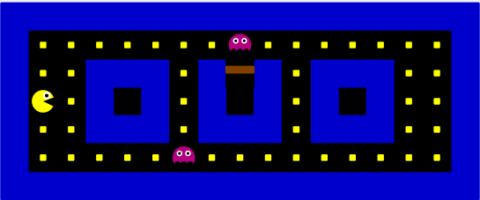


GHOST MODEL
How does ghost choose its input for each step?
$$k$$
$$k+1$$
Possible patterns:
1.
2.
3.
4.
Extraction of inputs from a cyclic, random choice among different patterns
Ghost model
Gargiulo – Giannotti – Grimaldi – Morghen University of Naples Federico II – July 2023
Optimization of Pac-Man strategies using Model Predictive Control
SLIDE 8

Slide 10




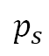
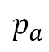
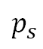
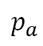
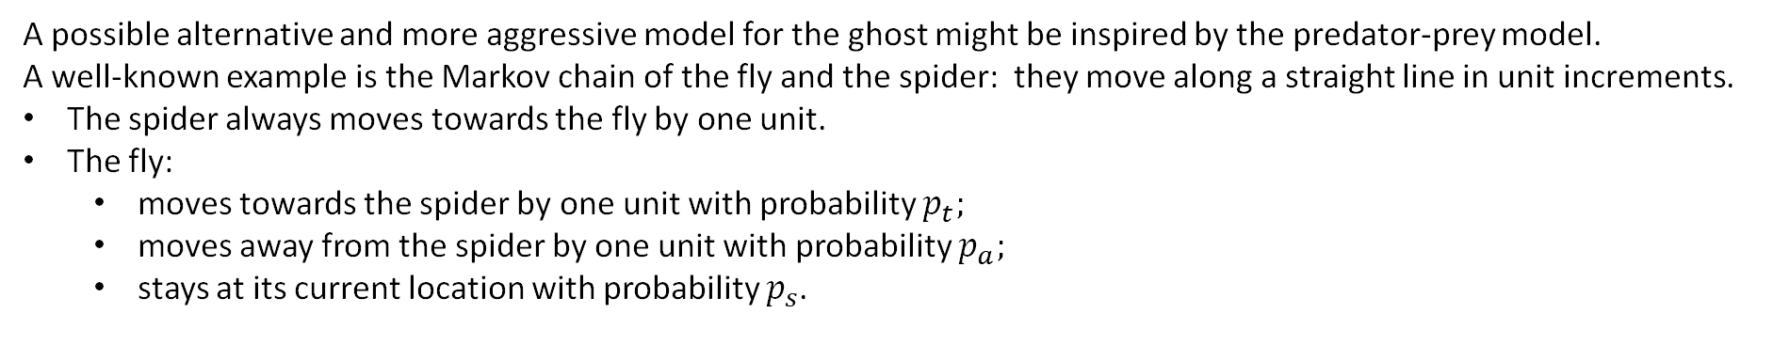
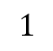
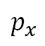
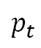
ALTERNATIVE GHOST MODEL
A possible alternative and more aggressive model for the ghost might be inspired by the predator-prey model.
A well-known example is the Markov chain of the fly and the spider: they move along a straight line in unit increments.
The spider always moves towards the fly by one unit.
The fly:
moves towards the spider by one unit with probability $p_{t};$
moves away from the spider by one unit with probability $p_{a};$
stays at its current location with probability $p_{s}$.
$$p_{a}$$
$$p_{t}$$
$$p_{s}$$
1
2
3
4
5
6
When the spider and the fly land in the same position or cross over each other, the spider captures the fly.
$$1$$
IN PAC-MAN
The idea can be replaced with the ghost acting as predator (spider) and pacman (who has uncertain movement compared to the ghost) acting as prey (fly). This allows us to implement a more aggressive ghost policy than the stochastic position (from his point of view) of Pac-Man.
The idea could also be turned around by providing for the use of power-up for Pac-Man.
$$p_{a}$$
$$p_{t}$$
$$p_{s}$$
1
2
3
4
5
6
$$p_{x}$$
$$p_{y}$$
Gargiulo – Giannotti – Grimaldi – Morghen University of Naples Federico II – July 2023
Optimization of Pac-Man strategies using Model Predictive Control
SLIDE 9

Slide 11



CONTROL STRATEGIES
PROBLEM FORMULATION
The artificial player will have to choose the direction in which to move by taking into account various objectives:
Minimize the number of steps useful for capturing all pills currently present;
Enact an escape policy the moment Pac-Man is below a critical distance from the ghost;
CONTROL STRATEGIES
Check on the distance between the positions of the ghost and Pac-Man (by considering the Euclidean norm as a metric) and "critical distance" to implement an aggressive or escaping policy.
Choose whether escape from the ghost (MPC) or collect all pills (TRAVEL SALESMAN PROBLEM)
${\left|\left|z_{p}−z_{g}\right|\right|}_{2}<critical_distance$ ?
Gargiulo – Giannotti – Grimaldi – Morghen University of Naples Federico II – July 2023
Gargiulo – Giannotti – Grimaldi – Morghen University of Naples Federico II – July 2023
Optimization of Pac-Man strategies using Model Predictive Control
SLIDE 10

Slide 12

YALMIP
YALMIP is a MATLAB toolbox
YALMIP supports a wide range of optimization problems, including linear programming (LP), mixed-integer linear programming (MILP), quadratic programming (QP) and nonlinear programming (NLP).
It also provides a convenient framework for formulating and solving MPC problems, when there is need to define:
the system
the objective function to be optimized
the constraints on the system variables
The YALMIP MPC formulation typically involves an optimization problem that is solved at each control interval to determine the optimal control inputs over a finite prediction horizon. In this context we used the GUROBI SOLVER!
Gargiulo – Giannotti – Grimaldi – Morghen University of Naples Federico II – July 2023
Optimization of Pac-Man strategies using Model Predictive Control
SLIDE 11

Slide 13
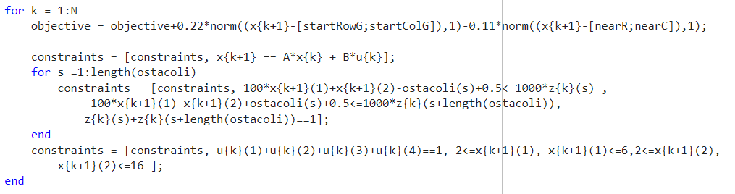
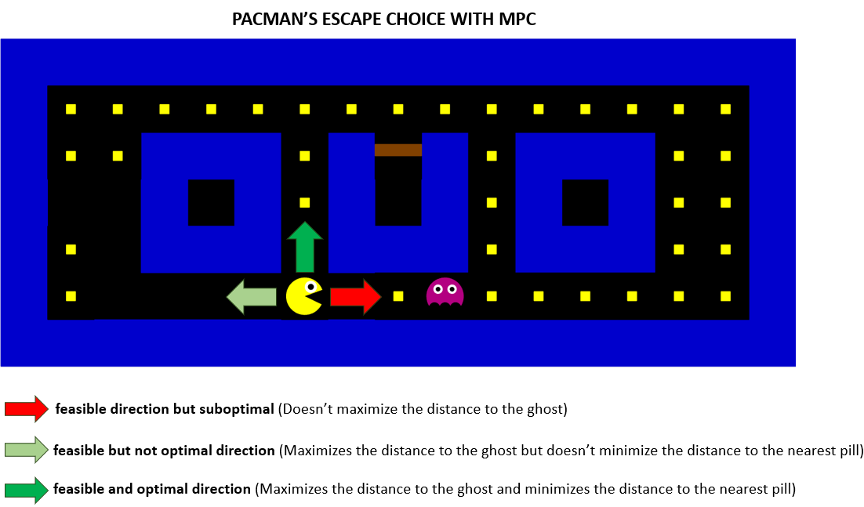
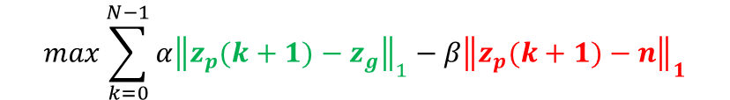
MODEL PREDICTIVE CONTROL 1/2
Objective Function:
Escape from the ghost
Find and try to reach nearest pill
$$max\sum_{k=0}^{N−1}{α{\left\|z_{p}(k+1)−z_{g}\right\|}_{1}−β{\left\|z_{p}(k+1)−n\right\|}_{1}}$$
The prediction horizon $N$ was set at 3.
The large number of tests we performed​ consistently reported successes using the following weights​ α = 0.22, β = 0.11 that demonstrates the efficiency of the​ control strategy.
Gargiulo – Giannotti – Grimaldi – Morghen University of Naples Federico II – July 2023
Optimization of Pac-Man strategies using Model Predictive Control
SLIDE 12

Slide 14
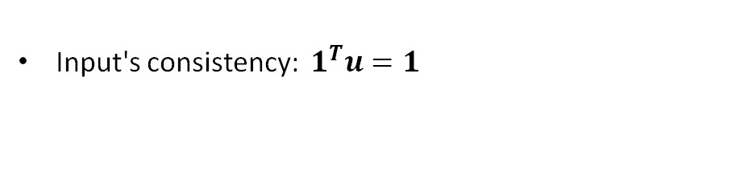

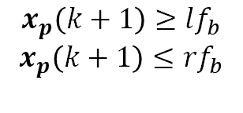

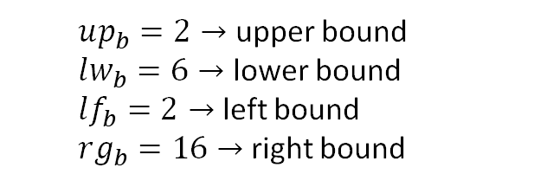
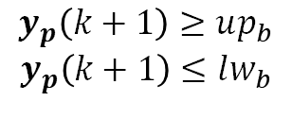
MODEL PREDICTIVE CONTROL 2/2
What about constraints? Three purposes:
Forcing Pac-Man remaining within the perimetral walls:
$up_{b}=2→$ upper bound
$lw_{b}=6→$ lower bound
$lf_{b}=2→$ left bound $rg_{b}=16→$ right bound
$$y_{p}\left(k+1\right)≥up_{b}$$
$$y_{p}\left(k+1\right)≤lw_{b}$$
$$x_{p}\left(k+1\right)≥lf_{b}$$
$$x_{p}\left(k+1\right)≤rf_{b}$$
Input's consistency: ${ 1}^{T}u=1$
Let Pac-Man avoids obstacles : MOST CHALLENGING!!
MATLAB IMPLEMENTATION CODE
Gargiulo – Giannotti – Grimaldi – Morghen University of Naples Federico II – July 2023
Optimization of Pac-Man strategies using Model Predictive Control
SLIDE 13

Slide 15

MODEL PREDICTIVE CONTROL 2/2
Let Pac-Man avoids obstacles WHY «MOST CHALLENGING»?
What happens when strict inequality constraints are written in Yalmip code? This is the response:
Gargiulo – Giannotti – Grimaldi – Morghen University of Naples Federico II – July 2023
Optimization of Pac-Man strategies using Model Predictive Control
SLIDE 14

Slide 16
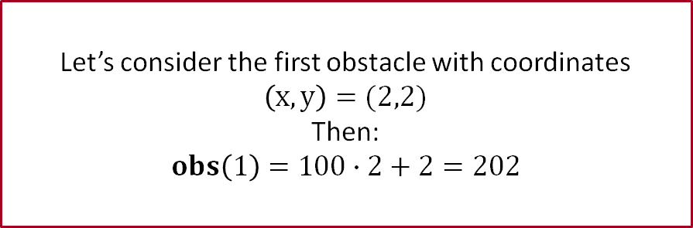
MODEL PREDICTIVE CONTROL 2/2
Key idea to handle a inequality constraints:
Transform obstacle’s coordinates as a unique number according to this rule:
$$obs\left(i\right)=100∙y+x$$
Example
Let’s consider the first obstacle with coordinates $\left(x,y\right)=(2,2)$
Then: $$obs\left(1\right)=100∙2+2=202$$
Gargiulo – Giannotti – Grimaldi – Morghen University of Naples Federico II – July 2023
Optimization of Pac-Man strategies using Model Predictive Control
SLIDE 15

Slide 17
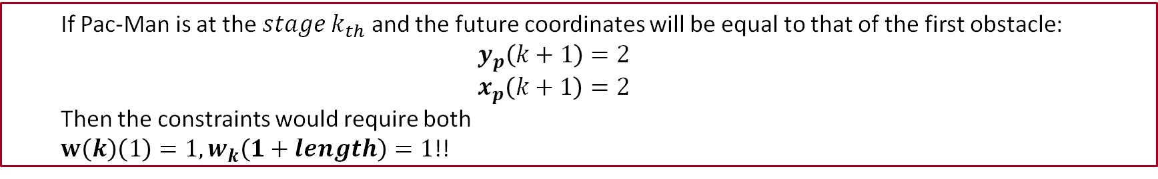
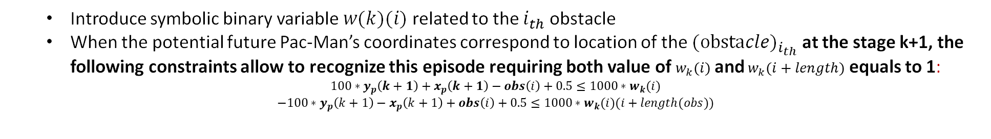
MODEL PREDICTIVE CONTROL 2/2
Key idea to handle a inequality constraints:
Transform obstacle’s coordinates as a unique number according to this rule:
$$obs\left(i\right)=100∙y+x$$
How to recognize an invalid pac man states evolution?
Introduce symbolic binary variable $w(k)(i)$ related to the $i_{th}$ obstacle
When the potential future Pac-Man’s coordinates correspond to location of the $(obstacl{e)}_{i_{th}}$ at the stage k+1, the following constraints allow to recognize this episode requiring both value of $w_{k}(i)$ and $w_{k}(i+length)$ equals to 1:
$$100∗y_{p}\left(k+1\right)+x_{p}\left(k+1\right)−obs\left(i\right)+0.5≤1000∗w_{k}(i)$$
$$−100∗y_{p}\left(k+1\right)−x_{p}\left(k+1\right)+obs\left(i\right)+0.5≤1000∗w_{k}(i)(i+length(obs))$$
If Pac-Man is at the $stage k_{th}$ and the future coordinates will be equal to that of the first obstacle:
$$y_{p}\left(k+1\right)=2$$
$$x_{p}\left(k+1\right)=2$$
Then the constraints would require both
$w\left(k\right)\left(1\right)=1, w_{k}\left(1+length\right)=1$!!
Example
Gargiulo – Giannotti – Grimaldi – Morghen University of Naples Federico II – July 2023
Optimization of Pac-Man strategies using Model Predictive Control
SLIDE 15

Slide 18

MODEL PREDICTIVE CONTROL 2/2
Key idea to handle a inequality constraints:
Transform obstacle’s coordinates as a unique number according to this rule:
$$obs\left(i\right)=100∙y+x$$
How to recognize an invalid pac man states evolution?
Introduce symbolic binary variable $w(k)(i)$ related to the $i_{th}$ obstacle
When the potential future Pac-Man’s coordinates correspond to location of the $(obstacl{e)}_{i_{th}}$ at the stage k+1, the following constraints allow to recognize this episode requiring both value of $w_{k}(i)$ and $w_{k}(i+length)$ equals to 1:
$$100∗y_{p}\left(k+1\right)+x_{p}\left(k+1\right)−obs\left(i\right)+0.5≤1000∗w_{k}(i)$$
$$−100∗y_{p}\left(k+1\right)−x_{p}\left(k+1\right)+obs\left(i\right)+0.5≤1000∗w_{k}(i)(i+length(obs))$$
How to avoid this situation?
Once recognized this unwanted situation it is avoided thanks to this constraint!
Just make sure that the sum of $w_{k}(i)$ and $w_{k}(i+length)$ is never equal to 2!
$$w\left(k\right)\left(i\right)+w\left(k\right)\left(i+length\left(obs\right)\right)==1$$
Gargiulo – Giannotti – Grimaldi – Morghen University of Naples Federico II – July 2023
Optimization of Pac-Man strategies using Model Predictive Control
SLIDE 15

Slide 19
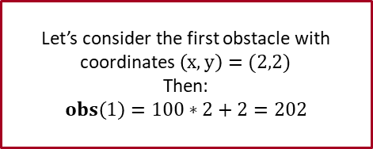
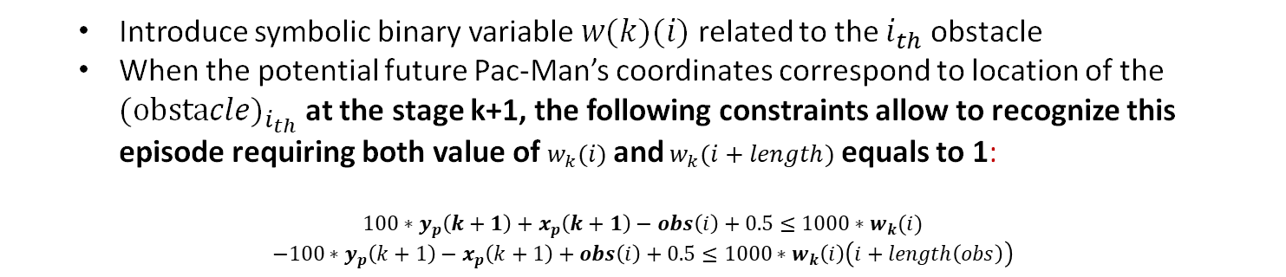
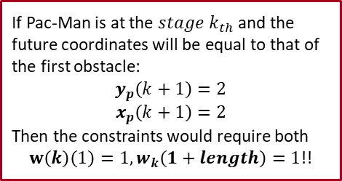
MODEL PREDICTIVE CONTROL 2/2
Key idea to handle a inequality constraints:
Example
Transform obstacle’s coordinates as a unique number according to this rule:
$$obs\left(i\right)=100∙y+x$$
Let’s consider the first obstacle with coordinates $\left(x,y\right)=(2,2)$
Then: $$obs\left(1\right)=100∗2+2=202$$
How to recognize an invalid pac man states evolution?
Introduce symbolic binary variable $w(k)(i)$ related to the $i_{th}$ obstacle
When the potential future Pac-Man’s coordinates correspond to location of the $(obstacl{e)}_{i_{th}}$ at the stage k+1, the following constraints allow to recognize this episode requiring both value of $w_{k}(i)$ and $w_{k}(i+length)$ equals to 1:
$$100∗y_{p}\left(k+1\right)+x_{p}\left(k+1\right)−obs\left(i\right)+0.5≤1000∗w_{k}(i)$$
$$−100∗y_{p}\left(k+1\right)−x_{p}\left(k+1\right)+obs\left(i\right)+0.5≤1000∗w_{k}\left(i\right)\left(i+length\left(obs\right)\right)$$
If Pac-Man is at the $stage k_{th}$ and the future coordinates will be equal to that of the first obstacle:
$$y_{p}\left(k+1\right)=2$$
$$x_{p}\left(k+1\right)=2$$
Then the constraints would require both
$w\left(k\right)\left(1\right)=1, w_{k}\left(1+length\right)=1$!!
How to avoid this situation?
Just make sure that the sum of $w_{k}(i)$ and $w_{k}(i+length)$ is never equal to 2!
$$w\left(k\right)\left(i\right)+w\left(k\right)\left(i+length\left(obs\right)\right)==1$$
Once recognized this unwanted situation it is avoided thanks to this constraint!
Gargiulo – Giannotti – Grimaldi – Morghen University of Naples Federico II – July 2023
Optimization of Pac-Man strategies using Model Predictive Control
SLIDE 15

Slide 20




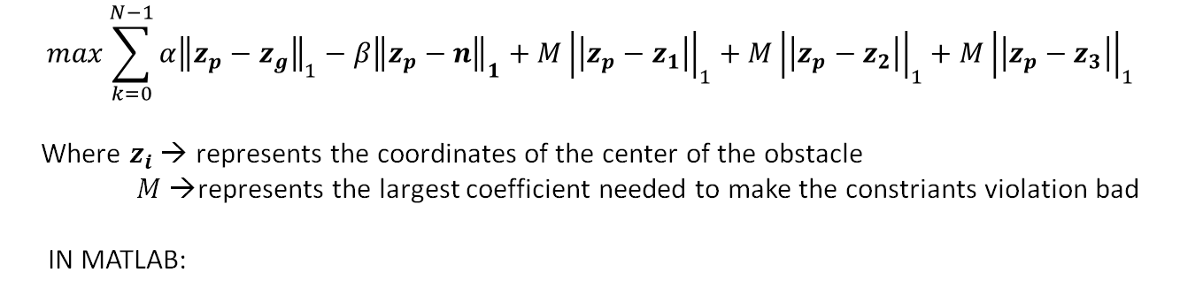




MPC - ALTERNATIVE COST FUNCTION
An alternative for implementing this constraint was to take it into account as an objective function.
$$max\sum_{k=0}^{N−1}{α{\left\|z_{p}−z_{g}\right\|}_{1}−β{\left\|z_{p}−n\right\|}_{1}+{M\left|\left|z_{p}−z_{1}\right|\right|}_{1}+{M\left|\left|z_{p}−z_{2}\right|\right|}_{1}+{M\left|\left|z_{p}−z_{3}\right|\right|}_{1}}$$ Where $z_{i}$→ represents the coordinates of the center of the obstacle $M$ →represents the largest coefficient needed to make the constriants violation bad IN MATLAB:
NOT A FEASIBLE SOLUTION !!!
Despite the weight in objective function, this does not allow us to be certain that the constraints are not violated.
Although there are matches in which the strategy works but there are some simulations and special cases that lead Pac-Man to make infeasible movements.
Infeasible trajectory
Gargiulo – Giannotti – Grimaldi – Morghen University of Naples Federico II – July 2023
Optimization of Pac-Man strategies using Model Predictive Control
SLIDE 16

Slide 21
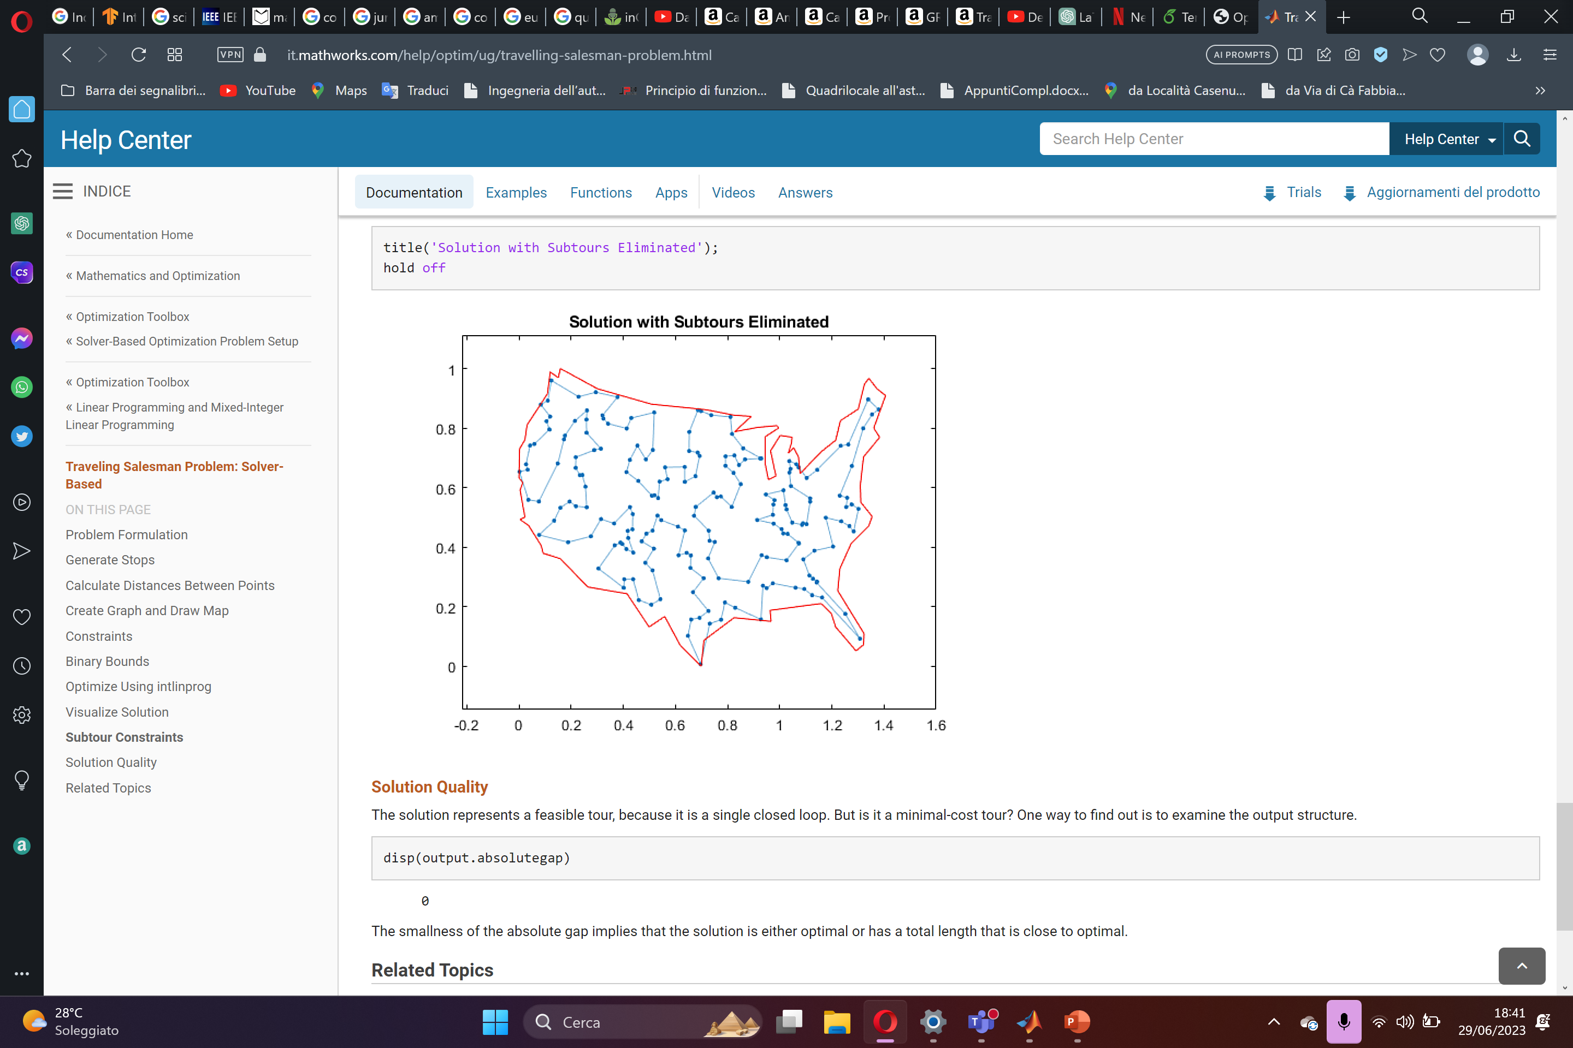


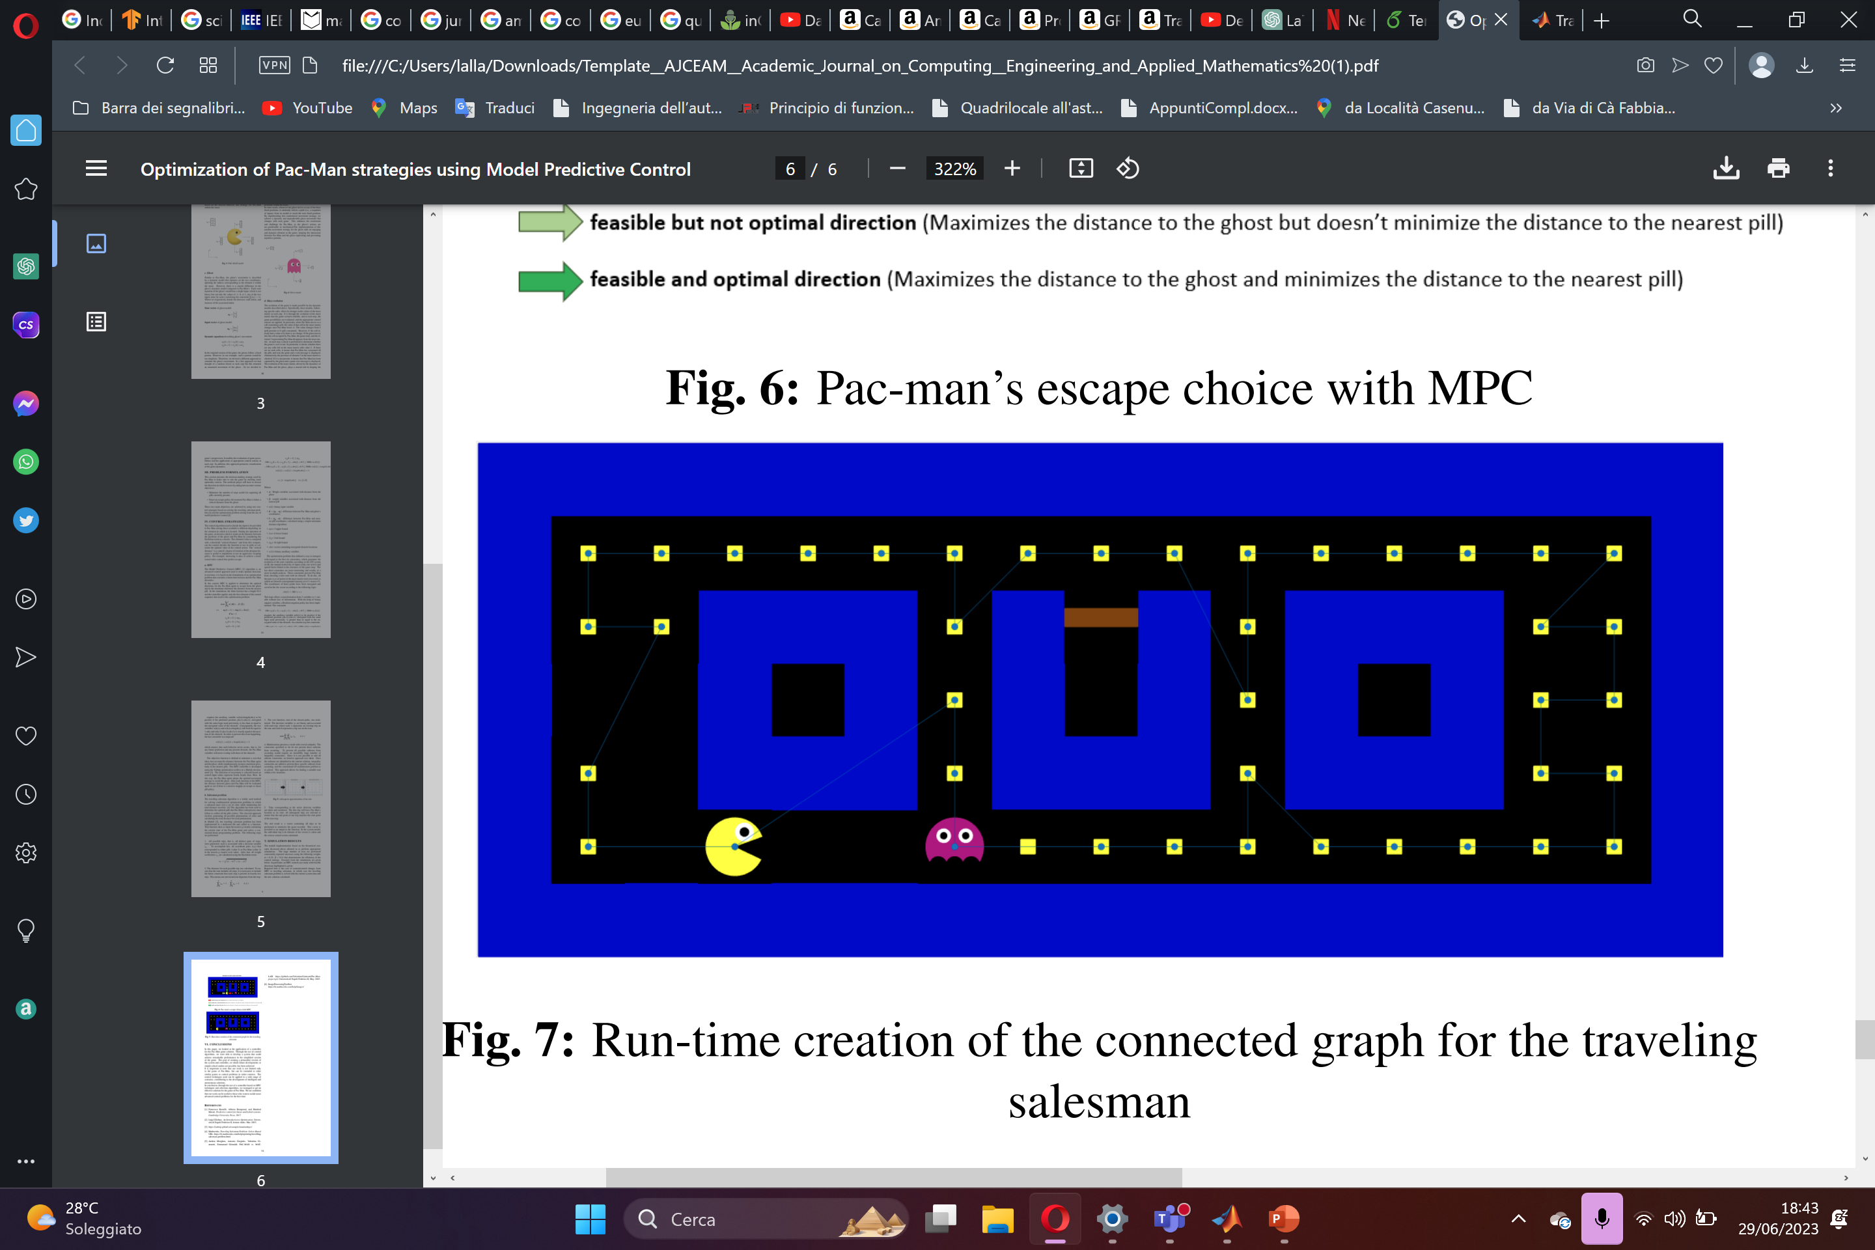
OPTIMIZATION PROBLEM: TRAVEL SALESMAN 1/4
The traveling salesman algorithm is a widely used method for solving combinatorial optimization problems in which a salesman must visit a set of cities while minimizing the total distance traveled.
This algorithm has been used to determine the optimal path that Pac-Man (salesperson) must follow to collect all the pills (cities).
Gargiulo – Giannotti – Grimaldi – Morghen University of Naples Federico II – July 2023
Optimization of Pac-Man strategies using Model Predictive Control
SLIDE 17

Slide 22
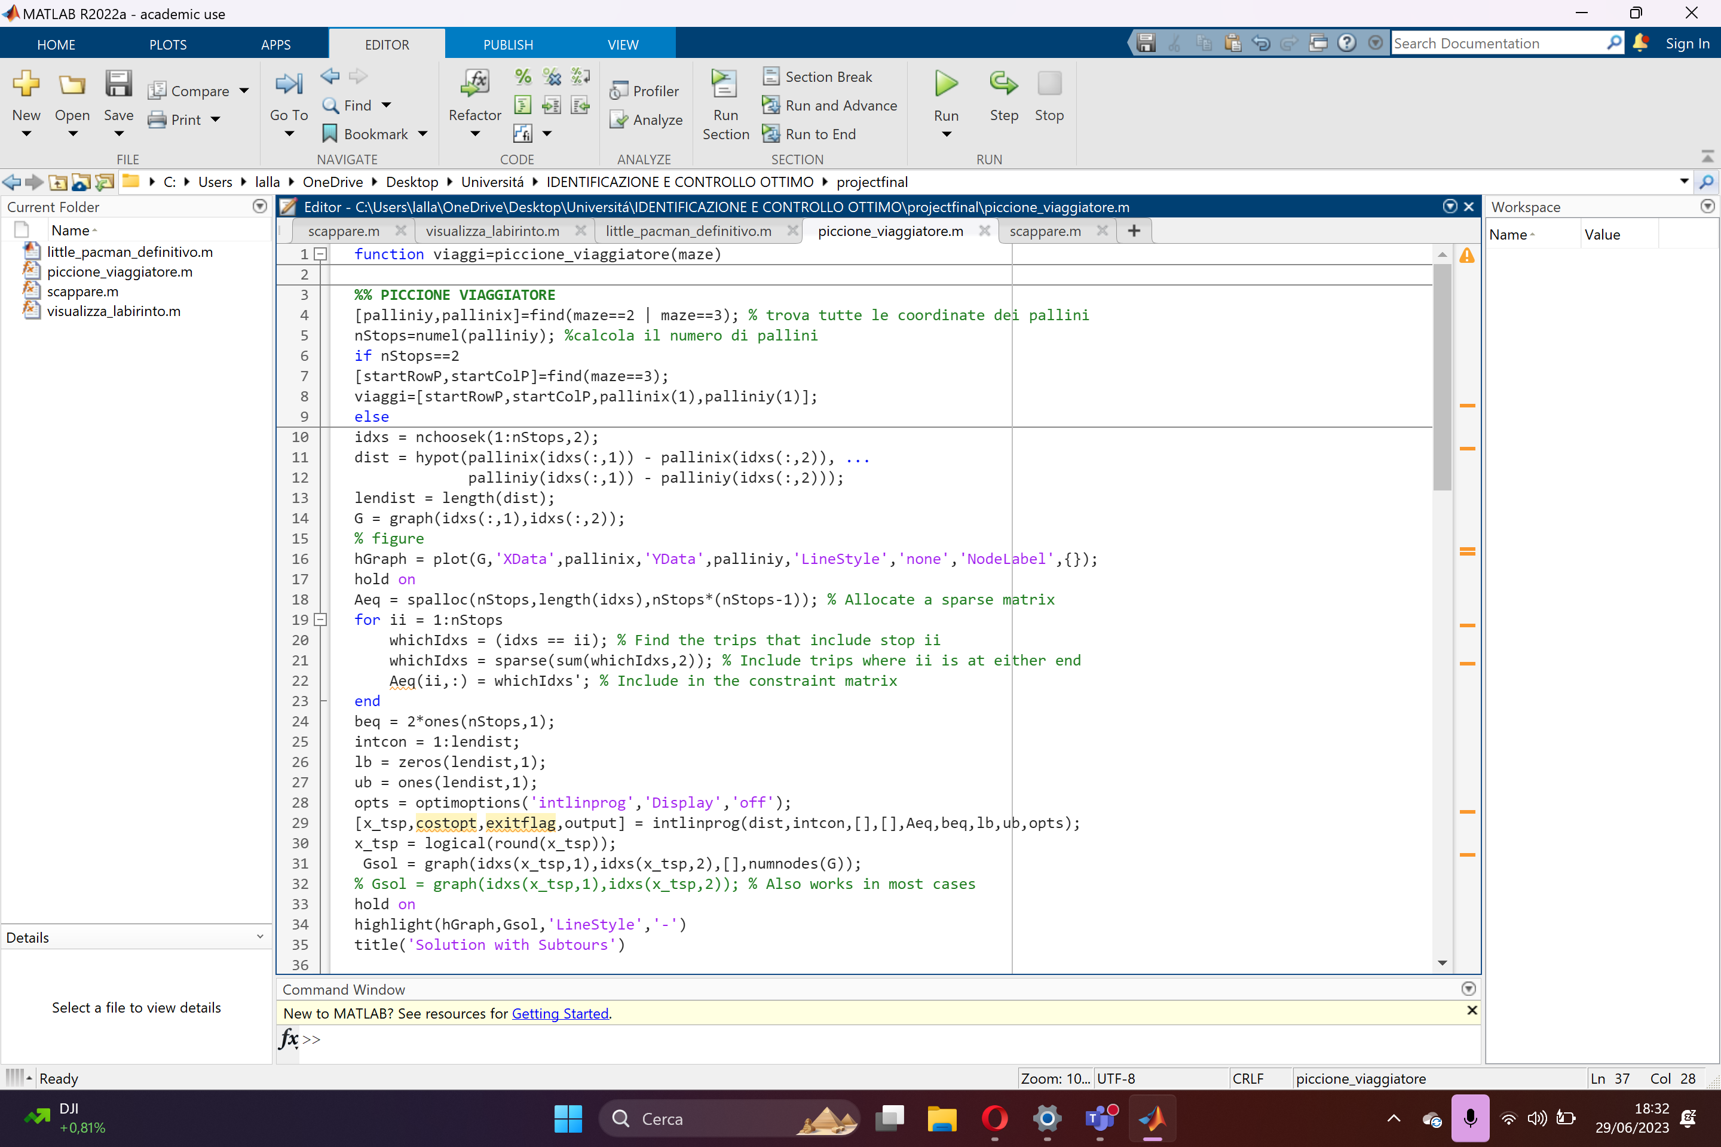


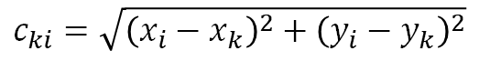

OPTIMIZATION PROBLEM: TRAVEL SALESMAN 2/4
STEP 1: SUBTOUR GENERATION
$$z_{ki}$$
The decision variables are binary and associated with each trip:
1 represents an existing trip on the tour
0 represents a trip not on the tour.
Weight coefficients are calculated using the Euclidean norm.
$$c_{ki}=\sqrt{{\left(x_{i}−x_{k}\right)}^{2}+{\left(y_{i}−y_{k}\right)}^{2}}$$
Constraint that each stop is present in exactly two trips.
$$\sum_{k=0}^{N}{z_{ki}}=1\sum_{i=0}^{N}{z_{ki}}=1 k≠i$$
Objective function:
$$\min{\sum_{k=0}^{N}{\sum_{i=0}^{N}{c_{ki}z_{ki}} }}k≠i$$
Gargiulo – Giannotti – Grimaldi – Morghen University of Naples Federico II – July 2023
Optimization of Pac-Man strategies using Model Predictive Control
SLIDE 18

Slide 23
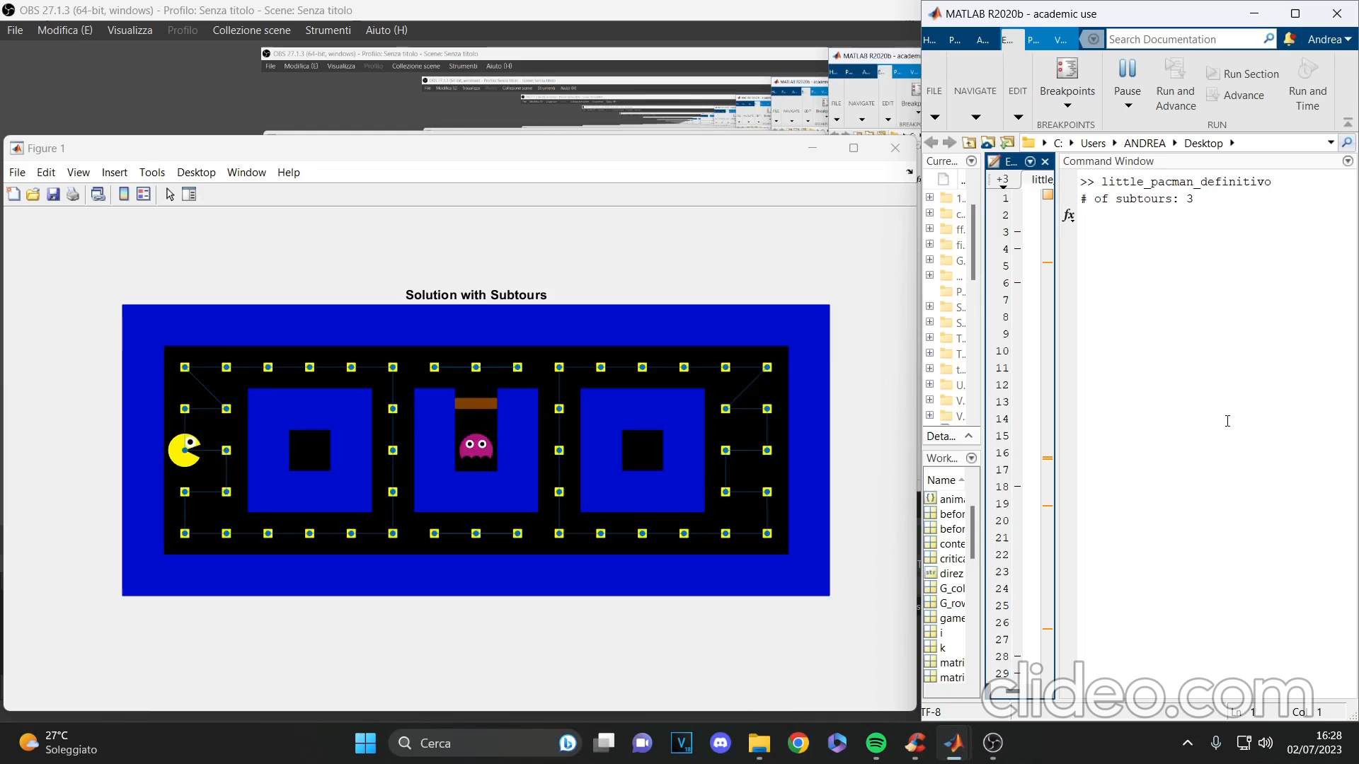

OPTIMIZATION PROBLEM: TRAVEL SALESMAN 3/4
STEP 2: SUBTOUR REDUCTION
subsequent approximations of the tour
Gargiulo – Giannotti – Grimaldi – Morghen University of Naples Federico II – July 2023
Optimization of Pac-Man strategies using Model Predictive Control
SLIDE 19

Slide 24

OPTIMIZATION PROBLEM: TRAVEL SALESMAN 4/4
STEP 3: SUBTOUR REDUCTION
Trips corresponding to the active decision variables are taken and reordered. The first trip will have Pac-Man’s location as its start, all subsequent trips are selected to ensure that the end point of one trip matches the start point of the next trip.
Gargiulo – Giannotti – Grimaldi – Morghen University of Naples Federico II – July 2023
Optimization of Pac-Man strategies using Model Predictive Control
SLIDE 20

Slide 25



CONTROL STRATEGIES IN MARKOV CHAIN’S IDEA
Example of solving with Policy iteration: a similar problem from «Reinforcement Learning: An Introduction»:
Another solution from literatures:
Design of Pac-Man Strategies with Embedded Markov Decision Process in a Dynamic, Non-Deterministic, Fully Observable Environment, Jiachang (Ernest) Xu
Example 4.1 from Reinforcement Learning: An Introduction
Gargiulo – Giannotti – Grimaldi – Morghen University of Naples Federico II – July 2023
Gargiulo – Giannotti – Grimaldi – Morghen University of Naples Federico II – July 2023
Optimization of Pac-Man strategies using Model Predictive Control
SLIDE 21

Slide 26









SIMULATION RESULTS
WIN
WIN
WIN
WIN
WIN
WIN
Gargiulo – Giannotti – Grimaldi – Morghen University of Naples Federico II – July 2023
Optimization of Pac-Man strategies using Model Predictive Control
SLIDE 22

Slide 27
FUTURE DEVELOPMENTS
It is important to note that our work is not limited only to the game of Pac-Man, but can be extended to other
similar games or control problems in wider contexts. The control techniques used can be applied to a wide range of scenarios, contributing to the development of intelligent and autonomous solutions.
The next challenges that might come are:
Implementation of additional and detailed game features;
Extension in multi-agent environment;
Improve the efficiency of control strategies and reduce computational load;
Portability of control strategy on different problems;
Application of control implementation to a real problem;
AND MUCH MORE…
Gargiulo – Giannotti – Grimaldi – Morghen University of Naples Federico II – July 2023
Optimization of Pac-Man strategies using Model Predictive Control
SLIDE 23

Slide 28
REFERENCES
Francesco Borrelli, Alberto Bemporad, and Manfred Morari. Predictive control for linear and hybrid systems. Cambridge University Press, 2017.
Luigi Glielmo, An Introduction to Optimization, Università di Napoli Federico II, lecture slides. Mar. 2023.
https://yalmip.github.io/example/standardmpc/
Mathworks, Traveling Salesman Problem: Solver-Based URL:https://it.mathworks.com/help/optim/ug/travellingsalesman-problem.html
Andrea Morghen, Antonio Gargiulo, Valentina Giannotti, Emmanuel Grimaldi. PAC-MAN vs. MATLAB. https://github.com/ValentinaGiannotti/Pac-Man-, Universita di Napoli Federico II, May. 2023.
ImageProcessingToolbox https://it.mathworks.com/help/images/
Design of Pac-Man Strategies with Embedded Markov Decision Process in a Dynamic, Non-Deterministic, Fully Observable Environment, Jiachang (Ernest) Xu
Gargiulo – Giannotti – Grimaldi – Morghen University of Naples Federico II – July 2023
Optimization of Pac-Man strategies using Model Predictive Control
SLIDE 24

Slide 29

Title
Gargiulo – Giannotti – Grimaldi – Morghen University of Naples Federico II – July 2023
Optimization of Pac-Man strategies using Model Predictive Control
SLIDE 19

